Slide 1

Mini-Project-IA Progress-II S.E. (Computer) Sem - III
 | Agnel Charitie’s Fr.C.Rodrigues Institute of Technology,Vashi Computer Engineering Department
2023-24

Slide 2
Budget Management System
Group members:[group no]
Graceton Santhmayor 1022246
Sarvesh Sawant 1022249
Swastik Sharma 1022251
Shaun Thomas Jacob 1022252

Slide 3
Presentation Outline
Abstract
Introduction
Literature Survey
Existing System
Proposed System
Conclusion
References

Slide 4
ABSTRACT
In today's fast-paced world, managing our finances efficiently has become more crucial than ever. The need for effective budget management arises from the ever-increasing expenses and the desire to achieve financial stability and security. Without proper budgeting, we may find ourselves struggling to meet our financial obligations, facing debt, and unable to reach our long-term goals. We present a strategy for keeping track of personal finances. The method offers a practical solution to efficiently manage cash and keep tabs on spending patterns. Users may input their income, create budgets for various cost categories, and track their financial performance through a user-friendly interface. Advanced algorithms are used by the system to assess expenditure trends and provide personalized budgeting advice. Users can get complete spending reports, see a financial data visualization, and get frequent reminders to stay on track. Additionally, the budget management system places a strong emphasis on data security and privacy, ensuring that private financial data is kept secure. It strives to enable people to take charge of their financial well-being, meet their savings objectives, and make wise spending decisions.
Keywords : Finances, User-friendly, Budget Management, Privacy, Financial well-being.

Slide 5
INTRODUCTION
Background
The expense tracking/management system is the latest service adapted in this world. As people have a shortage of time and they don't like keeping constant accounts of their transactions, this system does the work for them. It helps organise spending in an proper manner and compare the expenses with previous transactions, thus helping the user to plan sufficient savings for each month. It shows data in terms of pictorial representations such as pie charts and graphs which are easier to understand. Users can input their financial data, including income sources and expenses, to get an overview of their financial health. This application permits various aspects like expense tracking, income management, bill reminders, budgeting, customisation, security and a user-friendly interface.

Slide 6
INTRODUCTION
Motivation
A user-friendly tool for effective personal finance management is what encouraged us to develop a budget management system for individuals . As beginners in programming, we see this project as a valuable learning opportunity to acquire new skills. By offering a simple yet effective platform, we aim to promote financial awareness, responsible spending, and enhance the financial well-being of users. This mini-project provides an exciting chance to apply our academic knowledge to real-world applications and make a positive impact on people’s financial lives

Slide 7
INTRODUCTION
Aim & Objective
The aim of our project is to create a safe and user-friendly budget management solution. Our main goal is to build a simple platform that protects data privacy with different logins. Users will be given access to an easy-to-use screen where detailed budget details, including total revenue, expenses, and available balance, are displayed. Users can easily manage their financial data by providing options for tracking income and expenses. Additionally, users will have the freedom to set limits on spending for different expense categories, which will promote smart spending techniques. Through visual representations like charts or graphs, the technology will help users better understand their spending habits and spot areas for savings. Our goal is to create a flexible system that can respond to users' changing financial needs.

Slide 8
LITERATURE SURVEY
Mint budget app by Aaron Patzer
Idea mentioned in the paper
Mint.com is an online personal finance tool that enables users to monitor spending, establish budgets, and track financial health. For a complete overview, this free tool requires updating a few chosen financial accounts. Users can create customisable daily, weekly, or monthly reminders and keep tabs on their spending and credit scores.
Transaction categorization, which provides in-depth financial data, is a noteworthy feature. For accuracy's sake, purchases from several categories, such as "home improvement" and "groceries," can be divided. Cash spending tracking is helped by manual transaction entries. By selecting "cash" from the menu, the most recent ATM withdrawal will be properly deducted.
Financial awareness is improved by Mint's personalized notifications, which cover budget losses, changes to credit scores, and odd costs. For shared insights, alerts can also be forwarded to other recipients. In addition to categories, tags add another level of structure. For instance, tagging "fixed expenses" on top of categories might help determine how much money is allocated for monthly bills.
Technology/tool used:-Java, Javascript ,HTML,CSS

Slide 9
LITERATURE SURVEY
Good budget started in 2009 as an experiment by Dayspring Technologies
Idea mentioned in the paper
Goodbudget is a budgeting app that relies on the traditional envelope system to help users budget their monthly expenses. This app is a great fit for consumers who want to organize their priorities and get ahead financially.
The envelope system is designed to let you know how much money is allocated to each expense, along with how much is saved each month. Goodbudget provides excellent reporting tools to show your income against your spending, and how it varies month to month. In the app, there are easy-to-read graphs that can help you understand your spending habits.
When shopping for a budgeting app, digital security measures are essential because of the sensitive financial information used within the app.
Technology/tool used:- HTML , CSS , Javascript

Slide 10
LITERATURE SURVEY
Budget Estimator Android Application by Namita Jagtap, Priyanka Joshi, Aditya Kamble
Idea mentioned in the paper
The Expense Manager is a mobile application intended to run on android device namely smart phone. Expense Manager is designed to efficiently cater the needs of users by eliminating imparting costs and settling vows to friends. Aim is use better approaches to help users and their
companions to share expenses easily. This new application will let bunch users and their companions to have detailed view inside this application around individual costs. The app allows its users to add a remark to an expense, click on the expense name in any expense list. Bill posting will have space for comments and notes container with a "Post" catch underneath. The Expense Manager has notification option to notify each time somebody adds a remark to an expense user is on, or user can withdraw to posted bill.
Technology/tool used:- Java/kotlin , HTML , CSS

Slide 11
LITERATURE SURVEY
Pocket Guard by Igor Kuznetsov in 2014.
Idea mentioned in the paper
PocketGuard aims to simplify personal finance management by providing users with a comprehensive view of their finances, helping them track expenses, and offering insights to save money.
PocketGuard connects to users' bank accounts and credit cards to automatically categorize and track expenses. It provides real-time updates on spending and highlights bills, subscriptions, and potential savings. The app also offers budgeting tools, financial goal setting, and an "In My Pocket" feature that shows how much disposable income users have after accounting for bills and savings. Users can easily track their spending, identify areas for potential savings, and manage their budgets more effectively. The app's real-time updates provide a clear picture of financial health and help users make informed decisions.
Technology/tool used:- Java, Javascript ,HTML,CSS

Slide 12
CONTENT OF COMPARISON | Literature survey 1 | Literature survey 2 | Literature survey 3 | Literature survey 4 | TEAM PROJECT
IDEA PROPOSED | It is an Android application for tracking users expenses, setting budgets and providing financial insights. | It is Android as well as Web application. It helps users to allocate funds in traditional envelope system and prioritize expenses. | It is Android application. It aims to assist users in efficiently managing expenses by allowing groups to share costs and keep track of individual spending. | It is Android as well as Web application.It offers users a comprehensive view of their finances,real time spending updates,bill tracking and budgeting tools. | It is an Android Application. It offers a user friendly interface to enable users to add their expenses and track it in real time.

Slide 13
CONTENT OF COMPARISON | Literature survey 1 | Literature survey 2 | Literature survey 3 | Literature survey 4 | TEAM PROJECT
FEATURES AVAILABLE | MINT enables users to track spending across various categories, divide purchases from multiple categories, manually track cash spending, and receive personalized alerts for budget changes and credit score updates. | Goodbudget utilizes the envelope system or different expenses to allocate money . It offers reporting tools, easy-to-read graphs, and insights into income versus spending trends. | The Budget Estimator Android application enables users to share expenses within groups, categorize expenses, add remarks to expenses, and receive notifications for bill updates and comments. | PocketGuard connects to bank accounts and credit cards, categorizes expenses, offers real-time spending updates, highlights bills and subscriptions, and calculates disposable income after accounting for bills and savings. | Allow users to create an account with a unique and secure username and password. Presents an organized display of the users budget summary like total income, expenses and remaining balance and gives a monthly analysis.

Slide 14
CONTENT OF COMPARISON | Literature survey 1 | Literature survey 2 | Literature survey 3 | Literature survey 4 | TEAM PROJECT
PROGRAMMING LANGUAGE | Java, Javascript , HTML, CSS | HTML, CSS, javascript | Java/kotlin, HTML, CSS | Java, Javascript , HTML, CSS | Python, Kotlin, Javascript , HTML, CSS, Javascript and CSS frameworks

Slide 15
EXISTING SYSTEM
Mint budget app by Aaron Patzer
Idea
Mint.com is an online personal finance tool that enables users to monitor spending, establish budgets, and track financial health. For a complete overview, this free tool requires updating a few chosen financial accounts. Users can create customisable daily, weekly, or monthly reminders and keep tabs on their spending and credit scores.Transaction categorization, which provides in-depth financial data, is a noteworthy feature. For accuracy's sake, purchases from several categories, such as "home improvement" and "groceries," can be divided.
Drawbacks:-
Mint sometimes has trouble syncing with financial institutions. The app requires users to repeatedly sign into their accounts with those institutions within the Mint app to continuously sync. Mint says it is constantly improving the app and advises users experiencing sync issues to disconnect and reconnect their financial accounts. If that doesn't work, Mint recommends users uninstall the Mint app and reinstall it to force through any updates to the app.

Slide 16
EXISTING SYSTEM
Good budget started in 2009 as an experiment by Dayspring Technologies
Idea
Goodbudget is a budgeting app that relies on the traditional envelope system to help users budget their monthly expenses. This app is a great fit for consumers who want to organize their priorities and get ahead financially.
The envelope system is designed to let you know how much money is allocated to each expense, along with how much is saved each month. Goodbudget provides excellent reporting tools to show your income against your spending, and how it varies month to month.
Drawbacks :-
The envelope system is a unique personal finance philosophy that may not appeal to every user .Limited features

Slide 17
EXISTING SYSTEM
Budget Estimator Android Application by Namita Jagtap, Priyanka Joshi, Aditya Kamble
Idea
Expense Manager is designed to efficiently cater the needs of users by eliminating imparting costs and settling vows to friends. Aim is use better approaches to help users and their companions to share expenses easily.The app allows its users to add a remark to an expense, click on the expense name in any expense list. The Expense Manager has notification option to notify each time somebody adds a remark to an expense user is on, or user can withdraw to posted bill.
Drawbacks
The above mentioned application may not allow you to customize categories or reports to fit your unique financial situation. This can be frustrating if you have specific financial goals or need to track unusual expenses.

Slide 18
EXISTING SYSTEM
Pocket Guard by Igor Kuznetsov in 2014.
Idea
PocketGuard aims to simplify personal finance management by providing users with a comprehensive view of their finances, helping them track expenses, and offering insights to save money. The app also offers budgeting tools, financial goal setting, and an "In My Pocket" feature that shows how much disposable income users have after accounting for bills and savings.
Drawbacks
This app does not allow users to tailor the software to their specific needs. This lack of customization can be frustrating for individuals with unique financial situations.

Slide 19
PROBLEM STATEMENT
Our app is focused on helping individuals manage their personal finances effectively. The app will address various financial aspects, including expense tracking, income management, budgeting, financial goals, savings, investments, insights, and security. Users will be able to register, create profiles, and access features such as expense analysis, reminders, and financial tips. The goal is to create a user-friendly, secure, and cross-platform app that empowers users to make informed financial decisions and achieve their financial goals.

Slide 20
SCOPE
The scope for creating this budget management app involves several essential components. Firstly, it covers user management, including user registration, authentication, and profile management. Secondly, it encompasses the management of financial data, such as tracking expenses, managing income sources, setting and monitoring budgets, and establishing financial goals. The app will also provide financial tools for savings and investments management, generating insights into financial activities, and analyzing expenses. Users will receive assistance through reminders and alerts for financial tasks and access to useful financial resources. Data security and privacy will be paramount. Comprehensive documentation and representation will be created, and the project will include deployment, ongoing maintenance, and the integration of user feedback to continuously improve the app's features and usability. Scope for future enhancement will be implementation on android platform.

Slide 21
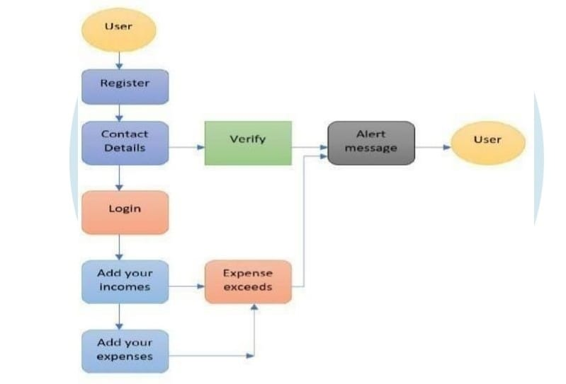
Flow chart

Slide 22
CONCLUSION
Thus, the proposed personal expense tracker helps customers to track their expenses there by saving time and energy and reduces complexity in maintaining a budget. Just a few second, you can save your money in better way. The financial data will also be presented in a graphical manner making it visually appealing to the user.This personal expense tracker is user-friendly , efficient in money management and it enhances the self control.

Slide 23
REFERENCES

Slide 24
Thank You!

